Slide 1
Eastern Avenue
Progress on Addressing Safety Issues and Upcoming Plans

Slide 2
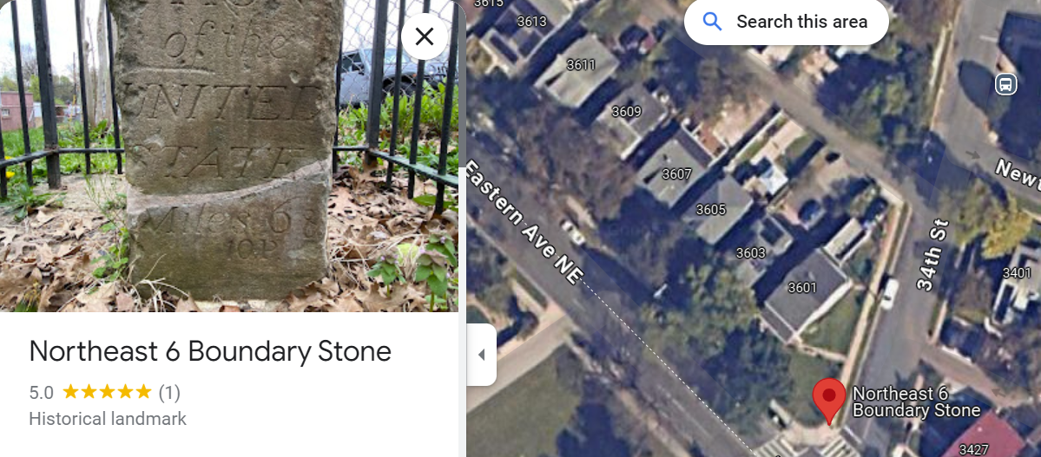
Reminder: Eastern Avenue is entirely in DC
DC includes:
Both northbound and southbound travel lanes
Sidewalks on both sides
Several feet into properties

Slide 3
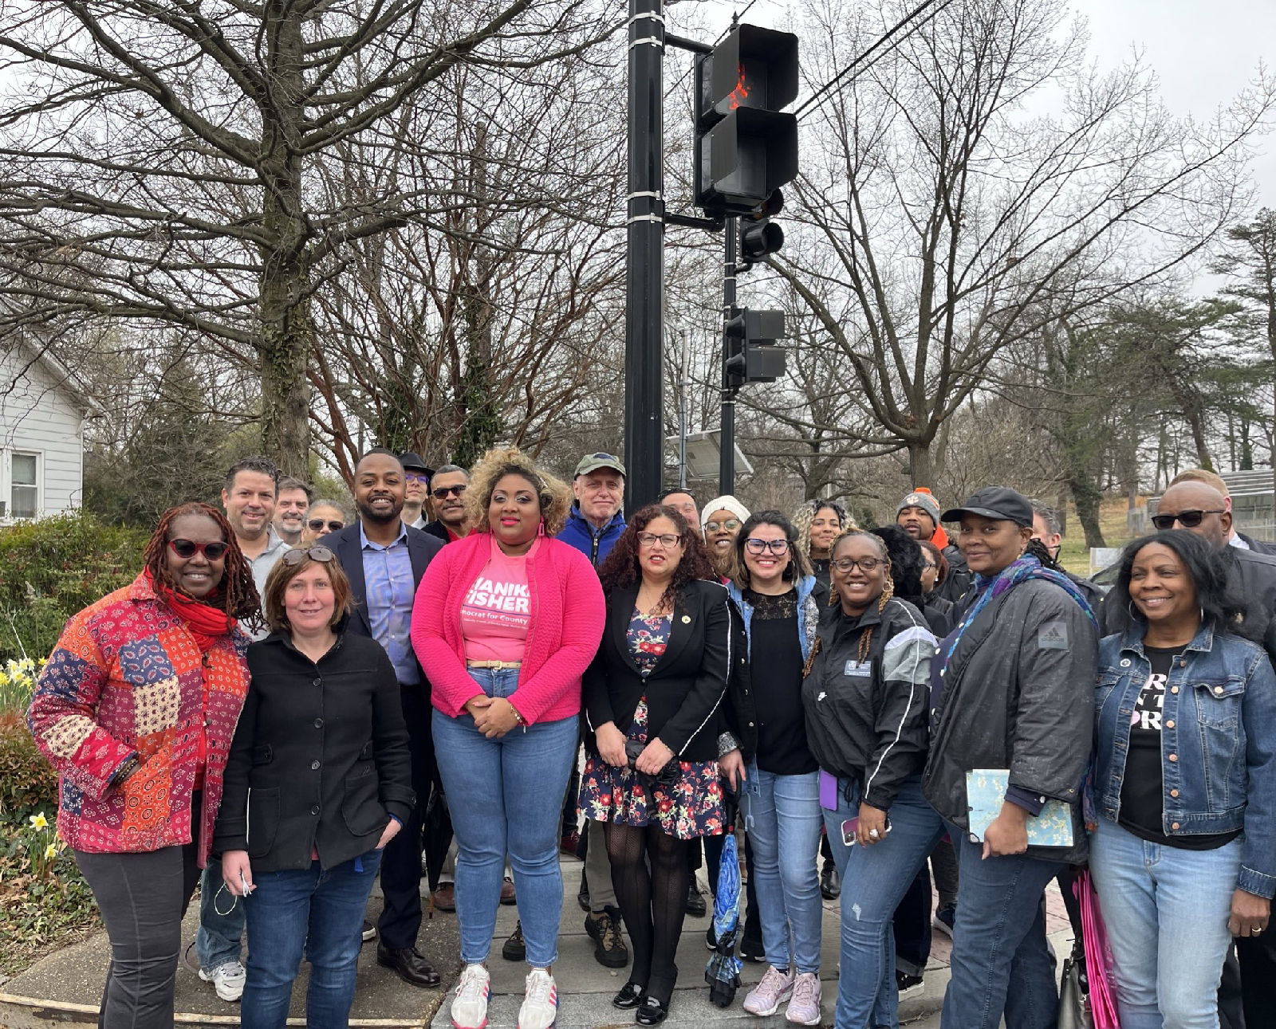
DC has sole control over changes to Eastern Avenue
HOWEVER:
Changes that DC make affect safety in the City of Mount Rainier.
Mount Rainier has no direct ability to make decisions in the District of Columbia - investments that are made with DC taxpayer funds - however, good relationships can make a difference!
Over the last few years, Mayor and Council have built good relationships with Councilmember Zachary Parker’s Office, ANC Commissioners Borrego and Brevard, and the District Department of Transportation (DDOT) to work on changes that improve mutual street safety. These efforts started in 2022 with the election of CM Parker and resulted in increased cross-border engagement.
DC/Mount Rainier safety walk

Slide 4
Following on-going communication from the City of Mount Rainier - from both city staff as well as Mayor and Council, DC has made a number of safety improvements and is proposing several more.

Slide 5
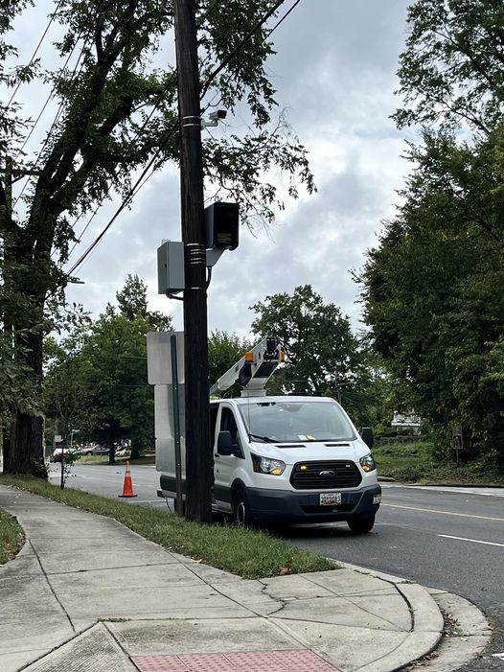
Improvements: Eastern Avenue Speed Cameras
DC is installing speed cameras on both north and southbound lanes on Eastern next to Bunker Hill/Randolph
Will be activated in the coming months

Slide 6
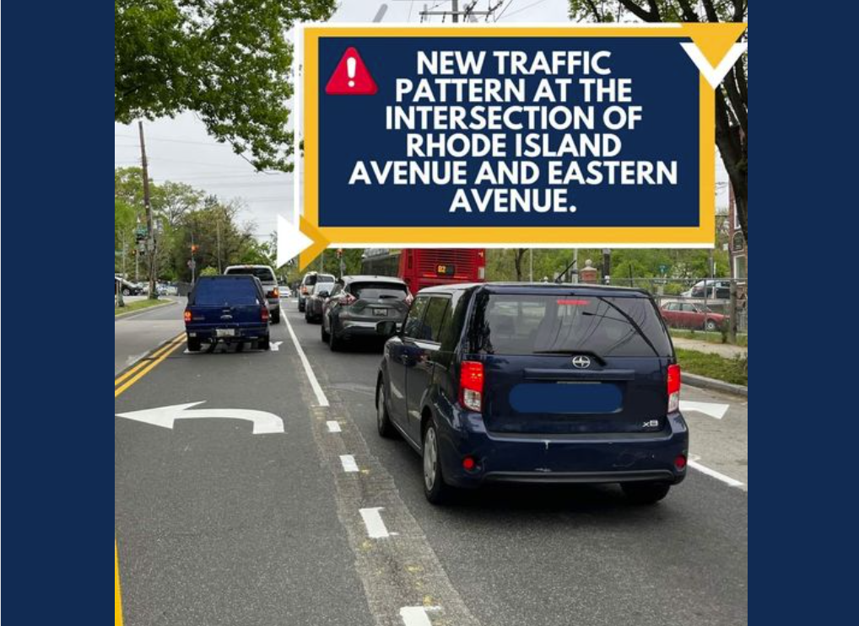
Improvements: Eastern Avenue/Rhode Island Intersection
Addition of left and right turn lanes on northbound Eastern Avenue
Addition of left and right turn lanes on southbound Eastern Avenue
No right turns on red at any approach

Slide 7
Planned Changes On Eastern
In Washington, DC, a Notice of Intent (NOI) is a written communication from the District Department of Transportation (DDOT) that informs the public of proposed changes to traffic and parking requirements. The NOI also solicits public comment on the proposed changes.
The DDOT issues an NOI when a safety treatment is recommended that would change existing traffic control or parking. The NOI includes a 30-day public comment period.

Slide 8
In response to a recent fatal crash on the 4000 block of Eastern Avenue NW, DDOT proposes quick -build safety treatments along Eastern Avenue SE between 30th Street and Russell Avenue NE.
These improvements include:
Adding a southbound left-turn bay to 28th Street
Adding a refuge island and daylighting at 28th Street
Continuing the hatched median on the 4000 block of Eastern Avenue
Adding left-turn bays on Eastern Avenue to Bunker Hill Road and Randolph Road
Installation of "No Turn on Red" signs at Eastern Ave and Randolph St NE/Bunker Hill Road intersection

Slide 9
DC Summary of Proposed Changes:
“These treatments will increase safety along Eastern Avenue for drivers and other street users
by visually narrowing lanes and reducing speeds as well as providing left-turn bays for turning vehicles to minor streets. The treatments will also increase pedestrian safety at uncontrolled crosswalks, with the pedestrian refuge island providing pedestrians with a safer crossing and improving pedestrian visibility for drivers to stop for those waiting to cross.
The treatments will also address the merging problem on the northbound Eastern Avenue approaching
Randolph St. With the new treatments, drivers will be required to merge into a single lane before the intersection.
To implement these improvements, DDOT will remove a total of 415 feet of potential parking
(equivalent to 21 car spaces on the west side of Eastern Avenue). Currently, this parking space has very
Low utilization and we have observed that large trucks frequently park for multiple days in this location”.
Additionally, DDOT plans to install "No Turn on Red" signs at Eastern Ave and Randolph St NE/Bunker Hill Road intersection to enhance pedestrian safety. Currently, this intersection has no restriction for right turns on a red traffic light. The installation of No-Turn on Red Sign will prohibit traffic turning right on a red light and enhance pedestrian as well as driver and passenger safety. Further, DC Council has passed legislation that asks DDOT to prohibit right turns on red signals at all signalized intersections unless otherwise signed.

Slide 10
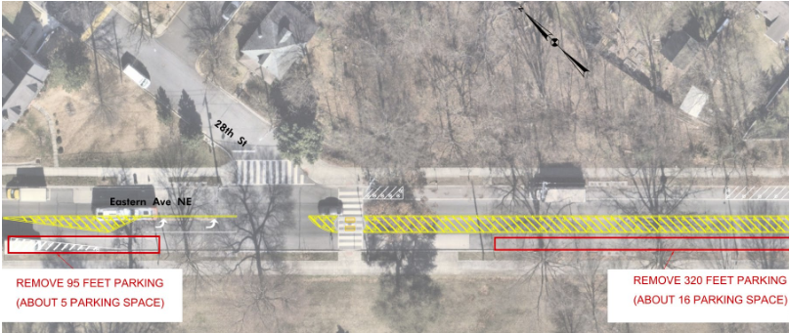
DC Proposed Change: Adding a southbound left-turn bay to 28th Street

Slide 11
DC Proposed Change: Adding a refuge island and daylighting at 28th Street

Slide 12
DC Proposed Change Continuing the hatched median on the 4000 block of Eastern Avenue

Slide 13
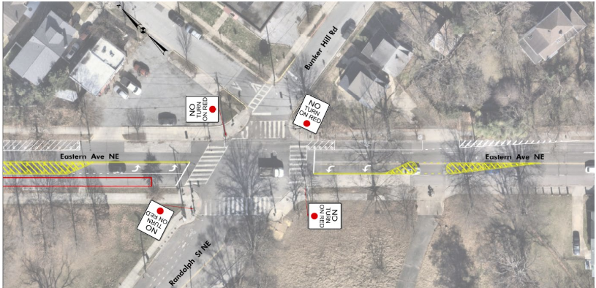
DC Proposed Change:
Adding left-turn bays on Eastern Avenue to Bunker Hill Road and Randolph Road
Installation of "No Turn on Red" signs at Eastern Ave and Randolph St NE/Bunker Hill Road intersection

Slide 14
Remove Parking Along Western Side of Eastern Avenue

Slide 15
Comments Due November 18th
Mayor and Council should submit a letter (with NOI proposals changes we support)
Adding a southbound left-turn bay to 28th Street?
Adding a refuge island and daylighting at 28th Street?
Continuing the hatched median on the 4000 block of Eastern Avenue?
Adding left-turn bays on Eastern Avenue to Bunker Hill Road and Randolph Road?
Installation of "No Turn on Red" signs at Eastern Ave and Randolph St NE/Bunker Hill Road intersection?
Parking Removal Along Eastern (Western Side)?

Slide 16
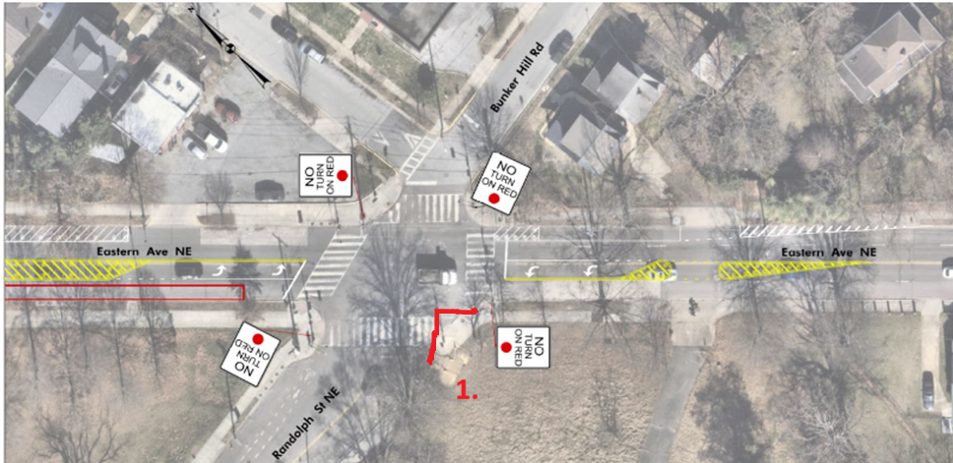
Additional Items of Support?
Suggest additional intersection daylight at Eastern/Rhode Island to slow down right-turn to Eastern and vehicles heading straight onto Bunker Hill

Slide 17
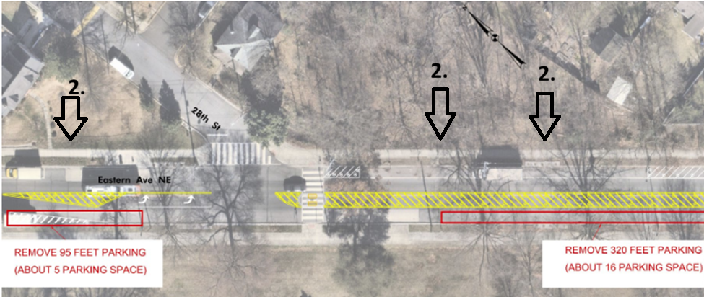
Additional Items of Support?
2. Suggest parking removal on eastern side of Eastern Avenue as well as western side of Eastern (to address commercial truck issues)

Slide 18
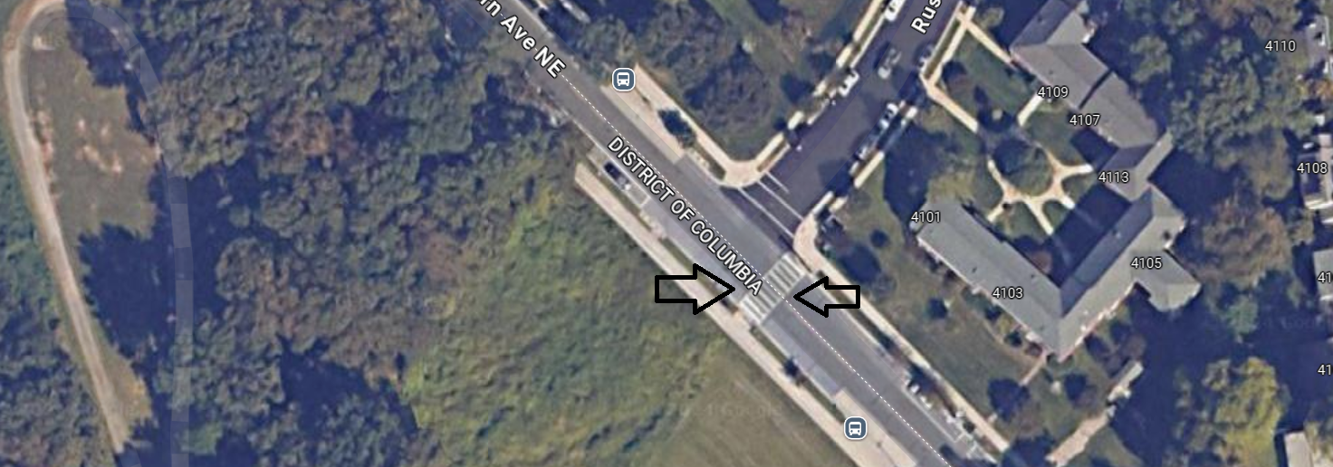
Additional Items of Support?
Suggest additional median/refuge for Eastern Avenue crossing at Russell

Slide 19
Future Longterm Plans for Eastern?
Longer-term plans should include more substantial retrofits:
DC’s future plans include potentially protected bike lanes on Eastern Avenue
Will provide connectivity to future Mount Rainier Safe Streets for All (SS4A) funded improvements
Request installation of these proposed NOI items as well as more robust permanent safety infrastructure in the long-term

Slide 20
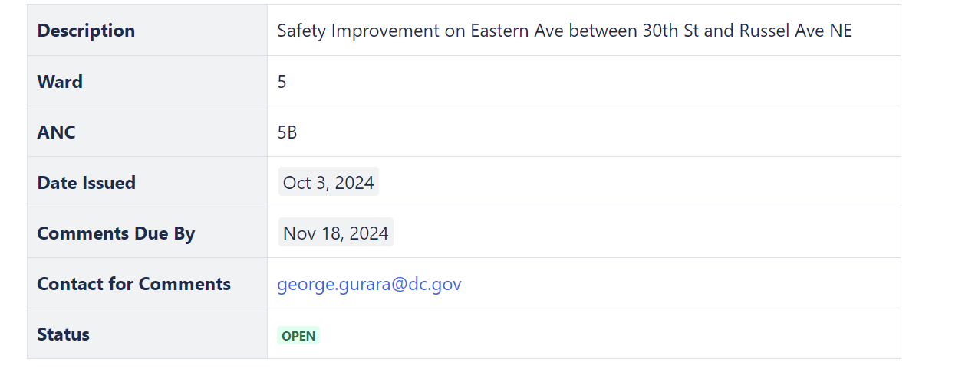
This NOI can be found on DDOTs website: NOI-24-266-TESD
https://ddotwiki.atlassian.net/
NOI-24-266-TESD

